Slide 1
Ground Rules
Be honest and respectful
Listen to understand
It’s okay to disagree, but do so with curiosity, not hostility
Be brief so everyone has an opportunity to participate

Slide 2
How does your unit reflect or differ from trends we’re seeing statewide?

Slide 3
Looking Ahead
What Shifting Demographics Mean for CSU and Strategic Enrollment Management
Division of Enrollment and Access
Leslie Taylor, Interim Vice President
Tom Biedscheid, Director of Financial Aid
Pushpa Lehene-Singh, Statistical Analyst, Office of Admissions

Slide 4
New Freshmen
What to Expect in the Future and
What We Can Learn from the Past

Slide 5
WICHE Projections
For 40 years, the Western Interstate Commission for Higher Education (WICHE) has produced Knocking at the College Door, projections of high school graduates. Widely used by policymakers, enrollment managers, college counselors, K-12 educators, researchers, and the media, the 9th edition of Knocking projects by state and race/ethnicity through the class of 2032.

Slide 6
Total U.S. Public and Private High School Graduates
School Years 2000-01 to 2012-13 (actual) through 2013-14 to 2030-2031 (projected)
2023
2017
Notes:
#1 The overall number of high school graduates will plateau for most of the next decade
After almost two decades of steady growth in the number of high school graduates averaging about 2% annually, the nation reached a high of about 3.46 million grads around 2013.
Between now and about 2023, there is virtually no increase projected.
The next increase is predicted around 2025, when the nation will produce about 3.5 to 3.6 million high school graduates
After 2025, the number of high school graduates nationally is projected to decrease steadily, to about 3.3 million.

Slide 7
Converging Populations, 2013-14 to 2031-32
(52%)
(48%)
Only showing race/ethnicity for public school graduates (90% of total graduates)
Notes:
#2 The racial/ethnic mix of high school graduates will continue to shift significantly toward a more diverse population
White public school graduates are projected to decrease by 17 percent by the early 2030s, about a quarter million fewer graduates than in 2013
Hispanic high school graduates are the primary growth population, increasing almost 50 percent by 2025, from 640 thousand in 2013 to almost 900 thousand.

Slide 8
Total U.S. Public and Private High School Graduates
By Race/Ethnicity, School Years 2000-01 to 2012-13 (actual) through 2013-14 to 2030-2031 (projected)
Private

Slide 9
Significant Regional Variation
Total Public and Private High School Graduates, 2000-01 to 2031-32
1,352,600
SOUTH
862,000
776,820
WEST
647,036
MIDWEST
NORTHEAST
Notes:
#3 There will be significant regional variations
The Northeast and Midwest regions will continue to decline throughout the projected years.
The South (particularly TX) will see steady and significant increases. By 2025, it will generate about 10 percent more graduates than in 2013 and is primarily responsible for the growth predicted for the nation around 2025.
The West will follow the national trend - with slight increases through 2025 and then decline.

Slide 10
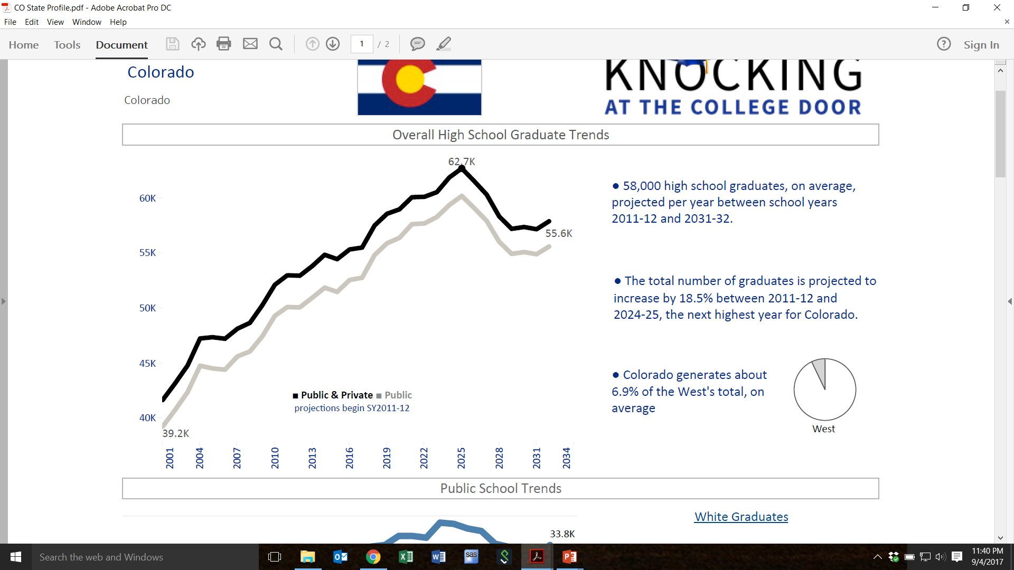
Colorado
Total Public and Private High School Graduates, 2000-01 to 2031-32

Slide 11
Fall Enrollment at CSU
The last 10 years
New Freshmen

Slide 12
Freshman Applications
Applications increased by about 60%

Slide 13
Freshman Applications: Residents vs Nonresidents
Resident applications increased by 25%, nonresident apps increased by 101%

Slide 14
Freshman Admits

Slide 15
Freshman Enrollment
Enrollment increased in 10 years by about 14%

Slide 16
Freshman Enrollment: Residents vs Nonresidents
Shift in the resident-nonresident mix

Slide 17
Diversity
Diverse students shown as a percent of enrolled class
Notes:
Yield in college admissions is the percent of students who choose to enroll in a particular college or university after having been offered admission

Slide 18
Class Profile and High Achieving
High achieving students shown as a percent of enrolled class
Average HS GPA for the entering class increased from 3.53 in 2008 to 3.62 for the most recent class
Percentage of the entering class described as “High Achieving” also increased

Slide 19
Yield
Percent of students who choose to enroll in a particular college or university after having been offered admission
Notes:
Yield in college admissions is the percent of students who choose to enroll in a particular college or university after having been offered admission

Slide 20
Yield
Despite the increase in applications, yield has been on a steady decline.
Notes:
Yield in college admissions is the percent of students who choose to enroll in a particular college or university after having been offered admission

Slide 21
Challenges ahead
  Declining yield
  Common Application
  Increased competition – more out of state schools are placing recruiters in CO to recruit students away
  Growth in high school graduates is in population with lower college going rates and also less mobile
  Survey of students who declined offer of admission at CSU cite cost of attendance as one of the main reasons

Slide 22
Financial Aid
What the Data Shows

Slide 23
Overall Cost of Attendance

Slide 24
Cost of Attendance by Component

Slide 25
Need and Merit Mix

Slide 26
Need and Merit Mix

Slide 27
Need and Merit Mix

Slide 28
Need and Merit Mix

Slide 29
Need and Merit Mix

Slide 30
Need and Merit Mix

Slide 31
Need and Merit Mix

Slide 32
Need and Merit Mix

Slide 33
Need and Merit Mix

Slide 34
Need and Merit Mix

Slide 35
Need and Merit Mix

Slide 36
All Loans
Notes:
Trends: Mix of loans, growth in non-institutional ---- Ave debt at grad ---- Default rate

Slide 37
Federal Direct Student Loans

Slide 38
Private Student Loans

Slide 39
Parent Loans

Slide 40
Loan Debt at Graduation
Current Default Rate
2.8%

Slide 41
Change in Enrollment by EFC Bands
06-07 to 07-08

Slide 42
Change in Enrollment by EFC Bands
06-07 to 08-09

Slide 43
Change in Enrollment by EFC Bands
06-07 to 09-10

Slide 44
Change in Enrollment by EFC Bands
06-07 to 10-11

Slide 45
Change in Enrollment by EFC Bands
06-07 to 11-12

Slide 46
Change in Enrollment by EFC Bands
06-07 to 12-13

Slide 47
Change in Enrollment by EFC Bands
06-07 to 13-14

Slide 48
Change in Enrollment by EFC Bands
06-07 to 14-15

Slide 49
Change in Enrollment by EFC Bands
06-07 to 15-16

Slide 50
Change in Enrollment by EFC Bands
06-07 to 16-17

Slide 51
What are the key enrollment challenges your unit will face in the next 10 years?

Slide 52
What is
Strategic Enrollment Management?

Slide 53
40+ years of Strategic Enrollment Management
1976
A process that brings together the often disparate functions having to do with recruiting, funding, tracking, retaining, and replacing students as they move toward, within, and away from the university.
Jack Maguire, Boston College

Slide 54
40+ years of Strategic Enrollment Management
1991
An organizational concept and a systematic set of activities designed to enable educational institutions to exert more influence on their enrollments. Organized by strategic planning and supported by institutional research, enrollment management activities concern student college choice, transition to college, student attrition and retention, and student outcomes.
Hossler, Evaluating Student Recruitment and Retention Programs

Slide 55
40+ years of Strategic Enrollment Management
2001
A comprehensive process designed to help an institution achieve and maintain optimum enrollment, where optimum is defined within the academic context of the institution. It’s a concept and process that enables the fulfillment of institutional mission and students’ educational goals.
Michael Dolence, AACRAO SEM 2001

Slide 56
40+ years of Strategic Enrollment Management
2004
A complex of concepts and process that enables the fulfillment of institutional mission and students’ educational goals.
Bob Bontrager, College & University Journal

Slide 57
40+ years of Strategic Enrollment Management
Today
A comprehensive and coordinated process that enables an institution to identify enrollment goals that are aligned with its mission, its strategic plan, its environment, and its resources, and to reach those goals through the effective integration of administrative processes, student services, curriculum planning, and market analysis.
Christine Kerlin, College & University Journal

Slide 58
Why focus Strategic Enrollment Management now?
The admissions arms race is escalating for Colorado students
Performance funding metrics
Demographics are changing
Costs are rising, with family incomes projected to be flat
Net tuition revenue is essential as fiscal support is decreasing
Resource allocation priorities and efficiencies
Growing expectations to demonstrating our value
Limits on tuition price increase

Slide 59
What does Strategic Enrollment Management include?
Marketing & Communications
Academic Programs
Data & Student Information Management
Registration
Financial Aid
Student Services
Orientation
Admissions
Housing & Dining
Student Success Initiatives
Strategic Enrollment Management Team
Course Capacity & Classroom Utilization
Retention Programs
Research & Analysis
Infrastructure & Capital Planning

Slide 60
What initiatives and strategies has your unit employed to impact enrollment?

Slide 61
What does Strategic Enrollment Management look like?
Clear goals for the number & types of students needed to fulfill our mission
Measurement of student success by access, transition, retention & graduation
Institutional success in terms strategic & financial planning
An accessible data-rich environment to inform decisions & evaluate strategies
Focus on improving process, organizational & financial efficiency, and outcomes
Intentional move toward on top quality student-centered service
Strong communication & collaboration among departments across the campus to support the enrollment program

Slide 62
What are we missing?
Structure

