Slide 1
Economic and Demographic Trends Facing Higher Education
Constructing a Mosaic

Slide 2
Components of the Mosaic Leave Universities Facing a Continuing Evolving Future
State Fiscal Position Suggests No New State Aid for Higher Ed
Household Financial Strength is More Affected by Student Loan Debt than Ever Before
Shifting Demographics will Affect the Pool of Prospective Students

Slide 3
State Aid
What Will the State Fiscal Position Mean for the Future of Higher Education Funding?

Slide 4
Higher Education has Grown in Total Appropriations

Slide 5
However, the Share of Total Appropriations from Public Support (State and Federal) has been on a Declining Trend

Slide 6
And Although for the First Time in CFC’s Decade of Forecasting the General Fund is Precariously Sustainable

Slide 7
CFC Forecasts that the Three Largest General Fund Departments will Continue to Command a Greater Share of the Budget

Slide 8
Resulting in All Other Expenditures Forecast to Continue to Decline as a Share of the General Fund

Slide 9
Perhaps as a Result Colorado’s Cost Advantage is Eroding.
Can Colorado Institutions Remain Competitive?

Slide 10
Student Loan Debt
In the Face of Limits on Public Support, What Will Household Financial Position Mean for Higher Education?

Slide 11
Student Loan Debt Increasing as a Share of Total Household Debt

Slide 12
Debt Growth as a Share of Total is a Result of Growth in Student Loan Debt More than Deleveraging of Other Debts…

Slide 13
…And Not Simply Attributed to Population Growth

Slide 14
Colorado’s Four Year Public Institutions Continue to Compare Favorably on Debt

Slide 15
But Remember This…

Slide 16
Can Colorado Continue to Compare Favorably on Debt Load when Tuition and Fees are Growing On Average 3X the Rate of Per-Capita Personal Income?

Slide 17
Demographics
How Will Changes to Colorado’s Age, Income and Ethnic Profile Affect Higher Education?

Slide 18
Colorado is Forecast to Grow, Although in Most Years “Future Students” Growing More Slowly

Slide 19
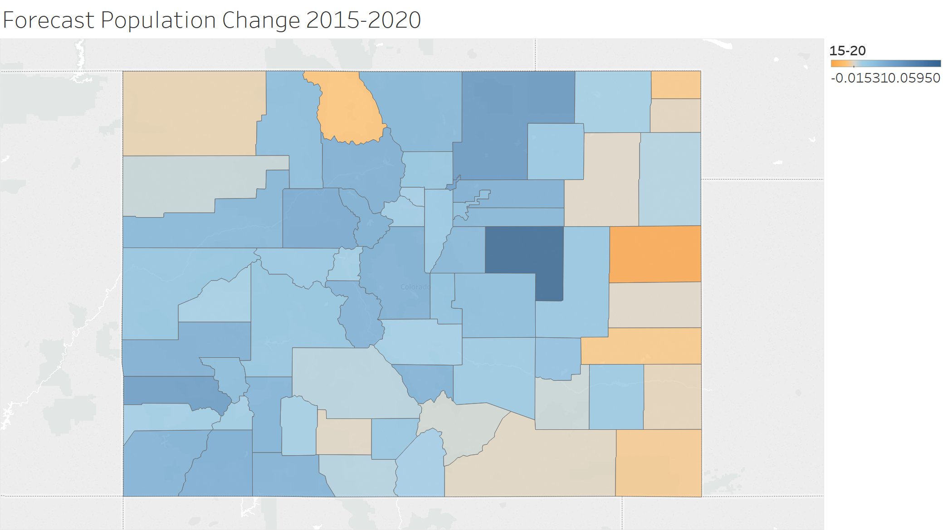
And the Growth is Not Geographically Uniform: 2015-2020

Slide 20
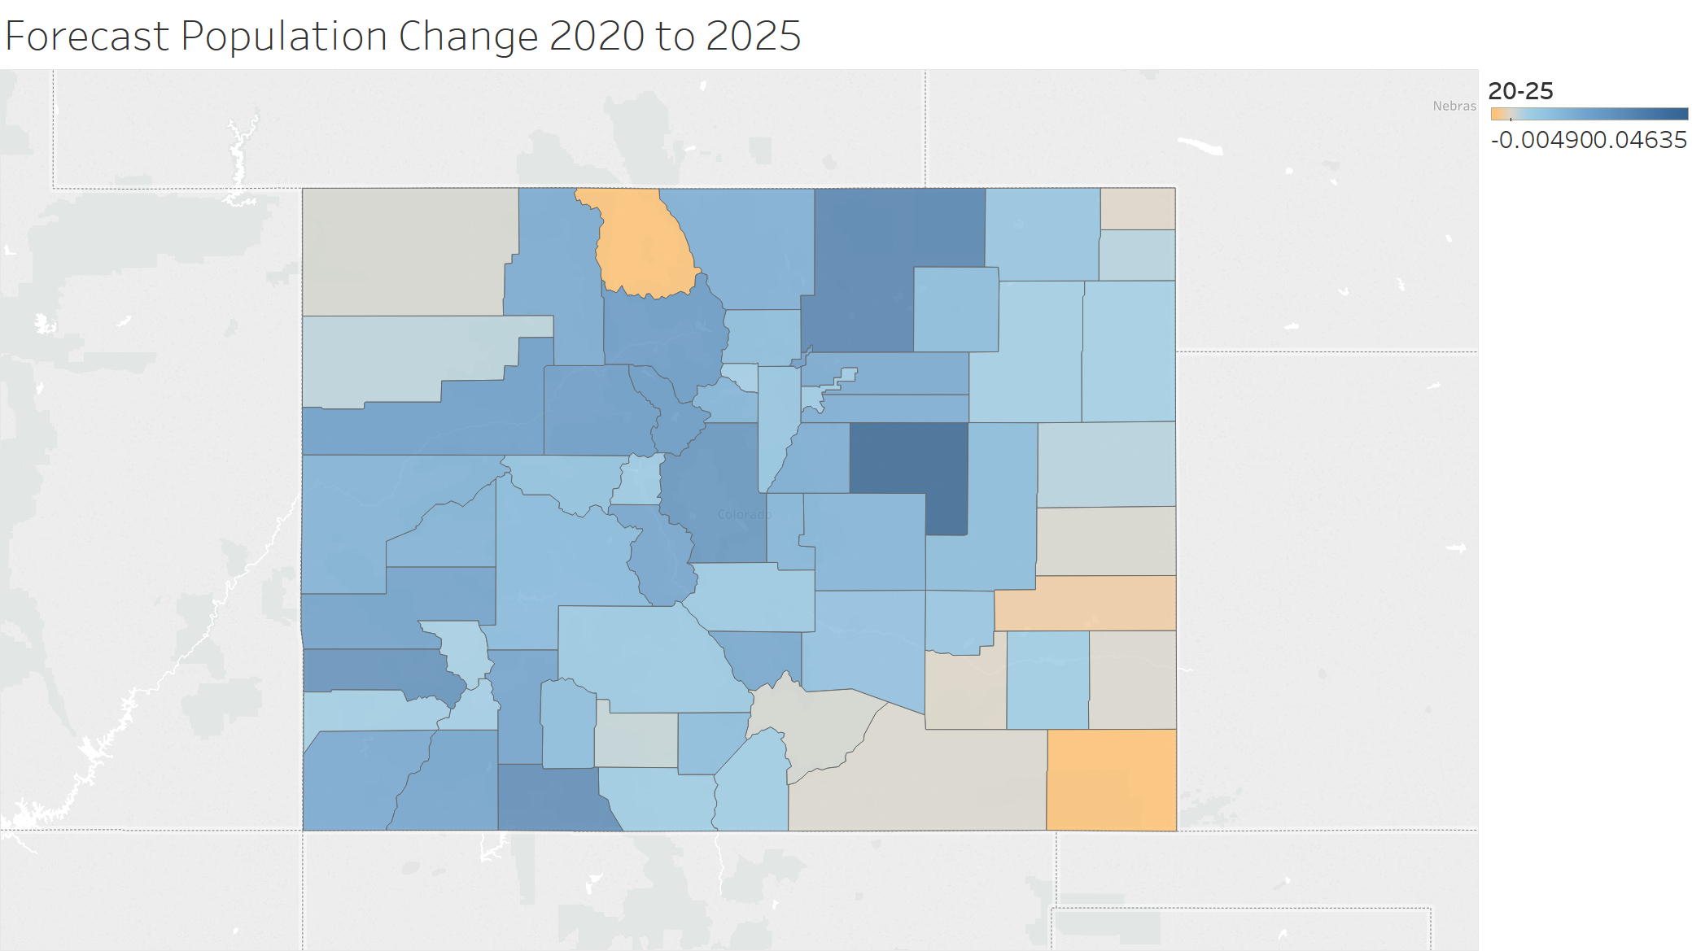
2020-2025

Slide 21
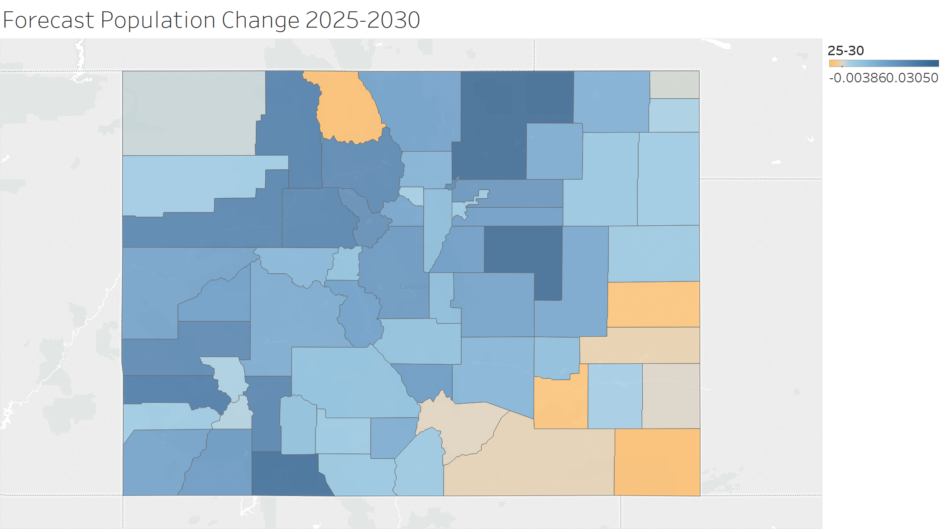
2025-2030

Slide 22
A Closer Look at “Future Students”

Slide 23
In the Past 10 Years, Freshman Resident Enrollment has been a Declining Share of Major Reference Age Cohorts.
Will the Declining Growth Rates in These Cohorts Present a Future Admissions Challenge?

Slide 24
“Future Students” will be Increasingly and Ultimately Majority Hispanic
Over Time, “Future Students” will be Increasingly and Ultimately Majority Hispanic

Slide 25
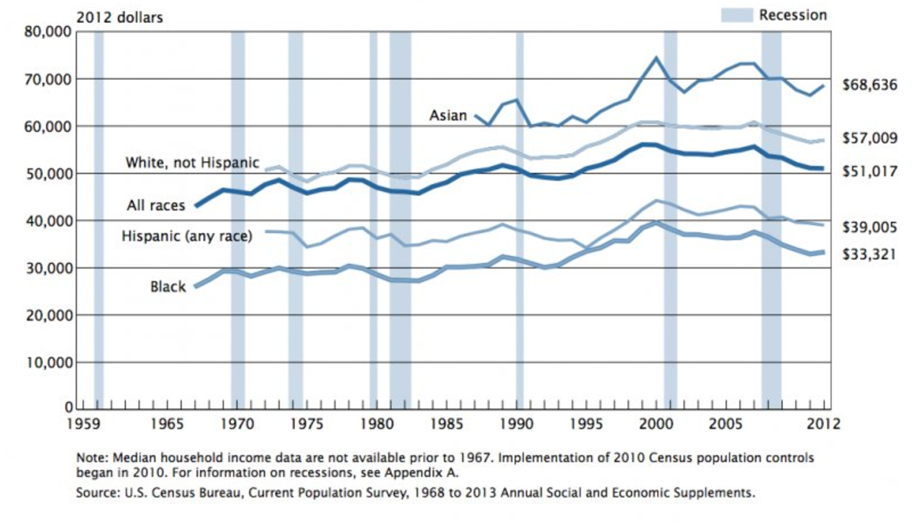
Historically, Hispanic Families Have Had Less Economic Capacity

Slide 26
Per Capita Personal Income Growth Projected to Slow. Will Households be able to Sustain Tuition and Fee Increases ?

Slide 27
Finally, What Will Be the Impact of a Less Homogeneous Colorado Population?

Slide 28
Forecast is for Even More Robust Growth from Migration, Particularly Outside the Metro Area

Slide 29
Conclude: A Mosaic of the Challenge

