Slide 1
Before you sit!
Make sure you are sitting next to someone new. Avoid sitting with people in your unit. It may be tricky, but try your best.

Slide 2
Campus Climate: What We’ve Learned, What We’re Doing and What’s Next
Assessment Group for Diversity Issues
President’s Commission on Women and Gender Equity (PCWGE)
Standing Committee on the Status of Women Faculty (SCSWF)
September 7th, 2017

Slide 3
Introduction
Campus climate: "the current attitudes, behaviors and standards of faculty, staff, administrators and students concerning the level of respect for individual needs, abilities and potential.”—Dr. Sue Rankin
Campus climate is associated with employees’ personal and professional development, job attitudes, perceptions of support, well being, health, retention, etc.
CSU has regular ongoing assessments of the campus climate and has recently assessed the climate via multiple methods that produced complimentary results
  Assessment Group for Diversity Issues
  Standing Committee on the Status of Women Faculty
  Presidential External Advisory Council (PEAC)

Slide 4
Assessment Group for Diversity Issues
Committee
  Designs and executes the Employee Climate Survey
Mission
  Further promote and develop an inclusive campus climate designed to welcome, encourage, and embrace differences so all community members are recognized, valued, and affirmed.
  Employee Campus Climate Assessments are designed to assess employee perceptions related to campus and their immediate workplace
  Results are intended to contribute to the adaptive management of campus/workplace climate by informing institutional efforts of continuous quality improvement

Slide 5
Employee Climate Survey
Methodology
  Survey Development
    Composition: 2014 results and solicitation from campus constituents
    Rotating constructs biennially with a core group of questions asked each administration
    Areas of Focus: Workload, work respect, leadership, search committees, the physical campus environment, diversity in the work environment, campus trainings, and campus perceptions
  Population
    All employees (anonymous)
  Dissemination and Implementation
    Presented to over 20 campus groups, disseminated online
    Used to inform current and future initiatives
Notes:
30% response rate
Focus groups followed

Slide 6
Employee Climate Survey Findings
2016 assessment finds consistent and significant differences by employee category
  Overall, faculty respondents have less favorable campus climate perceptions, while administrative professional respondents have more favorable.
  Over two-thirds of respondents agree that there are inequities and accountability differences among employment categories
  State classified respondents have particular feelings of disrespect and inequity based on their employment category and/or job type
Respondents of an underrepresented race/ethnicity and those who identify as self-identify, transgender, and/or non-binary report experiencing more negative treatment and disrespectful behaviors than their peers
Female administrative professional respondents had significantly less favorable scores for Accountability Standards and their perceptions of both CSU and their unit compared to males
Notes:
BOLDING SOME KEY WORDS WHERE THESE FINDINGS TEND TO CONVERGE W/ SCSWF AND PEAC FINDINGS/RECOMMENDATIONS

Slide 7
Employee Climate Survey Findings
Employees perceived Executive Leadership and Accountability Standards as the least favorable constructs and CSU perceptions and Work Respect as most favorable
  Workload showed a wide variance among employees
Physical environment and perceptions of accountability standards were most predictive of employees’ unit perceptions and work respect, while Executive Leadership was the most influential area on CSU perceptions
Overall, perceptions of CSU and individual units stayed relatively similar from 2014
  64%: CSU’s climate has become consistently more inclusive of all employees (58% in 2014)
  67%: CSU recruits employees from a diverse set of backgrounds (57% in 2014)
  63%: My unit creates a supportive environment for employees from diverse backgrounds (68% in 2014)
Notes:
BOLD SHOWS CONVERGENCE W/ SCSWF AND PEAC

Slide 8
President’s Commission on Women and Gender Equity
MISSION: To promote an environment that fosters productive and supportive relationships and interactions among people. . . in which people of all gender identities are supported and recognized; feel safe; are freed from limitations and restrictions of culturally defined sex roles; and in which all members of the campus community feel empowered and supported.
We make recommendations to the President
LONG TERM GOAL: To make ourselves obsolete
http://cwge.colostate.edu/

Slide 9
CSU Context – Women’s Initiative
1997: President Al Yates created: President’s Commission on Women and Gender Equity at CSU.
. . . . 20 years of RECOMMENDATIONS. More recently . . .
2012, ’14, ‘16 Campus wide climate survey - men and women, all staff
2013-2014: Senior CSU women faculty met with President Frank and Provost Miranda to express concerns
2014: Standing Committee on Status of Women Faculty created to address challenges facing women faculty
2014: SCSWF survey to faculty – key areas for faculty; narratives
2015-2016: Follow up qualitative study to understand deeper concerns
2017: Campus-wide Open Forum on SCSWF Campus Climate
2017: President Frank builds Presidential External Advisory Council

Slide 10
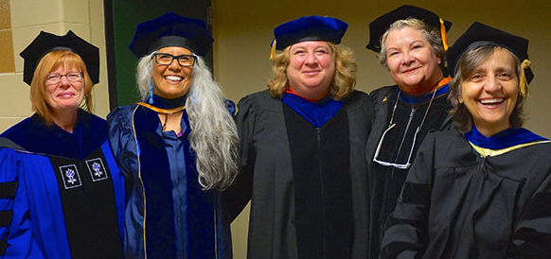
Standing Committee on the Status of Women Faculty
Committee
Mission
  …focuses explicitly on issues impacting the work life, campus climate, and persistent barriers inhibiting success of women faculty…special attention to global and national climates for academic women... offer recommendations for ways CSU might help counter pervasive national challenges related to women in academia, including disciplines where women are historically and currently underrepresented… including women in senior academic and leadership positions.
http://cwge.colostate.edu/standing-committee-on-the-status-of-women-faculty/home/

Slide 11
Standing Committee on the Status of Women Faculty
Methodology
  Need for study
    Differs from but compliments the climate survey
  Spring 2016
  Population
    Women faculty
  Qualitative
http://cwge.colostate.edu/standing-committee-on-the-status-of-women-faculty/home/

Slide 12
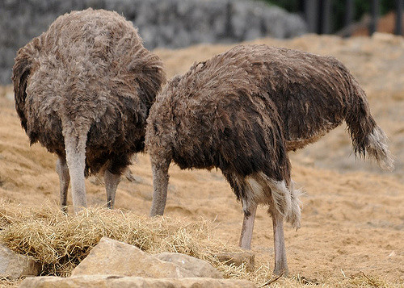
“We know from research that when change is proposed, particularly arising from reports like these, there is organizational resistance, particularly to the message being presented and the people presenting the message – especially if we are not attentive to our own desire to resist change.”
- Bridges, 2009

Slide 13
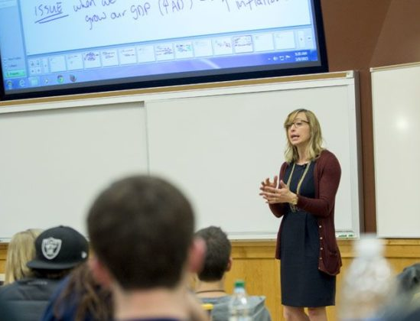
Convergence of Data
Campus Climate survey results
  Data on faculty, staff
  Disseminated results to relevant groups
  who developed recommendations
SCSWF Climate Study
  Year-long research study with external researcher
  Interviews & focus groups
  Developed recommendations
Presidential External Advisory Council
  Meetings with stakeholder groups
  Developed recommendations
Climate Committee Taskforce

Slide 18
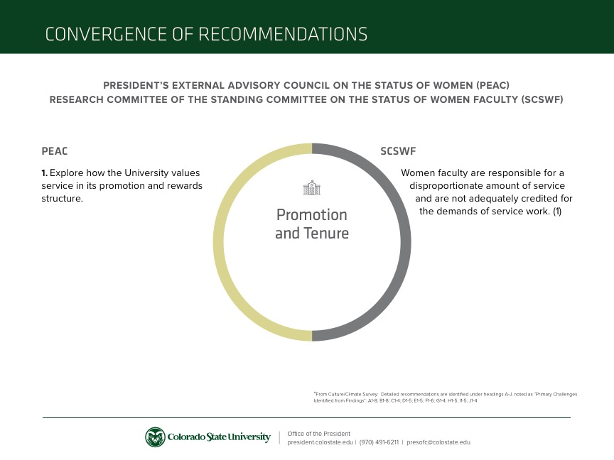

Slide 19
Emerging Themes: ACT
Accountability/consistency/transparency
Training/education
Behavior/bullying/toxic work environment
Workload/fairness
Microclimate
Inequities/otherness
Discrepancies between employment categories
University vs. Work Unit
Executive leadership
Accountability
Consistency
Transparency

Slide 20
Recommendations for CSU
Accountability measures
Training opportunities for leadership
Review policies & procedures, including annual evaluations
Consistently apply policies across units
Continue salary equity evaluations
Unit level assessment and focus
Data dissemination and communication throughout the pipeline
Collaboration between campus groups with similar missions
Develop mechanisms to recognize service

Slide 21
Examples of Recent & Ongoing Work
Mandatory campus wide supervisory training
Recommendations/changes to the search committee process
Campus Climate committee who utilizes the survey results in its work moving forward
Results widely disseminated and presented almost two dozen times
Follow up focus groups
Unit level focus and counsel
Diversity strategic plans
Collaborating with other universities who utilized our survey for potential benchmarking data
Additional diversity trainings offered across campus in response to items from the campus climate survey

Slide 22
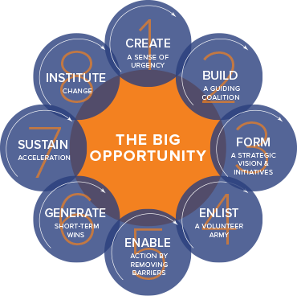

Moving Forward
Working closely with Tony F.
Each of us is critical in this effort
Changing the culture and climate of a large organization is a well-studied process
Accelerate : building strategic agility for a faster moving world, John P. Kotter. Boston, Massachusetts : Harvard Business Review Press , 2014
https://www.kotterinternational.com/8-steps-process-for-leading-change/

Slide 23
Accelerate : building strategic agility for a faster moving world, John P. Kotter. Boston, Massachusetts : Harvard Business Review Press , 2014

Slide 24
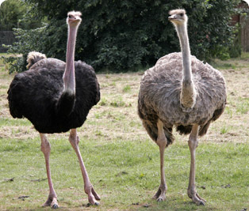
“Change is hard, but it’s what we do, and after all, not changing is even harder.”
- President Tony Frank, 2016

Slide 26


